Slide 1
Credit
Submitted by-
Satish Sharma
Shrujan Kulkarni

Slide 2
Business Objectives
This case study aims to identify patterns which indicate if a client has difficulty paying their installment
s which may be used for taking actions such as denying the loan, reducing the amount of loan, lending (to risky applicants) at a higher interest rate, etc. This will ensure that the consumers capable of repaying the loan are not rejected. Identification of such applicants using EDA is the aim of this case study.
In other words, the company wants to understand the driving factors (or driver variables) behind loan default, i.e. the variables which are strong indicators of default.

Slide 3
Reading application_data.csv
Shape of the dataframe: (307511, 122)
There are around 41 columns with missing values more than 50%.
Deleting or removing these 41 columns will drop down the dataframe to shape: (307511, 81).

Slide 4
Imputation of data
There are only few columns which have missing values lesser than 13%. Here are few approaches to impute data for few columns-
'DAYS_LAST_PHONE_CHANGE': There's just 1 missing value. We wont impute this record and simply ignore it.
'CNT_FAM_MEMBERS': There are two missing values in this column. By finding the mean and median using describe(), we get values 2.152665 and 2 respectively. Since Family members cant be in decimals we shall choose median to impute these records.
'AMT_ANNUITY': There are only 12 missing values in this column. We shall impute this using the median() value since the mean() method of imputation is susceptible to outliers.
'AMT_GOODS_PRICE': There're 278 missing values. We shall chose to impute this using the median value since the mean() method of imputation is susceptible to outliers.
'NAME_TYPE_SUITE': There're 1292 missing values. Since this is a Categorical column, we can use 'Unaccompanied' as this class has more number of occurrences.

Slide 5
Changing the datatype and the way data is populated for few columns-
TARGET is wrongly interpreted as int column. This column is representing 'clients with payment difficulties' and 'all other cases' and thus these columns cannot be int.
WORK_EXP and DAYS_BIRTH are both in negative numbers. Changing them into more meaningful data i.e. in Years

Slide 6
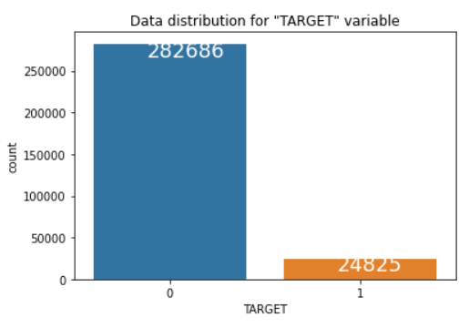
Imbalance percentage
As seen there’s a great imbalance between the data with Imbalance ratio = 11.38

Slide 7
Divinding the dataframe into two
After dividing the shape of the dataframe into two, the shape for them changes to-
Shape of Target0: (230302, 85)
Shape of Target1: (21835, 85)

Slide 8
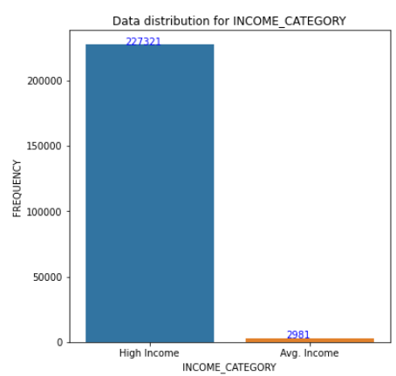
Univariate analysis of Categorical Variables for TARGETO :INCOME_CATEGORY

Slide 9
Understanding from the plot-
Applicants with High Income outnumber the applicants with Avg. Income. This could be because High Income applicants decide to avail loan for various luxurious things as they can afford to repay the loan unlike Avg. Incomed applicants.

Slide 10
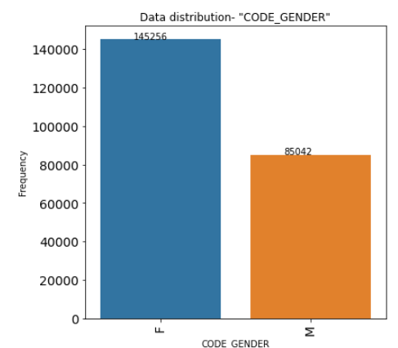
Univariate analysis of Categorical Variables for TARGETO Gender

Slide 11
Understanding from the plot-
Female applicants are quite higher in number of applicants. This could be due to Government may have started several schemes, subsidized the ROI where Women can benefit better than Men. This may also lead to cases where Woman in a family would apply for a loan instead of Man from her family thus increasing the count.

Slide 12
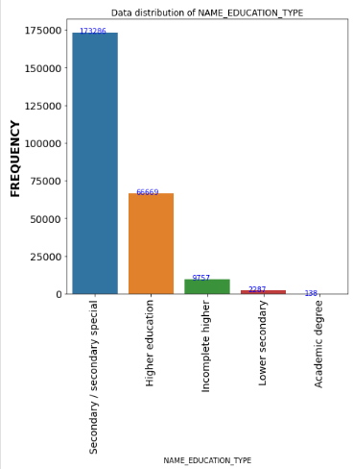
Univariate Analysis of Categorical Variables for TARGETO Name_Education_Type

Slide 13
Understanding from the plot-
As observed, the number of 'Secondary/Secondary' special type educated applicants is high. This could be because these people would applying loans for Higher education in Foreign Universities, where the fees is higher.

Slide 14
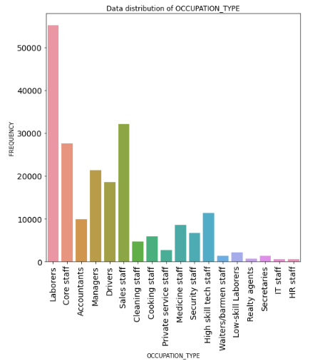
Analysing Occupation_Type to check loan defaults

Slide 15
Understanding-
As observed, Labourers are unable to pay back their loan and are the ones whose Defaulting rates are higher than any other category. Clearly, as known Labourers dont earn enough money to run a family and re pay their loan.

Slide 16
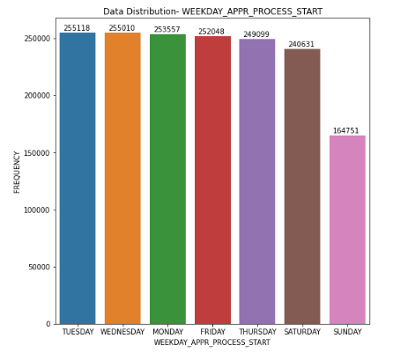
Univariate Analysis on merged data

Slide 17
Understanding-
As observed, Number of loan applicants are higher on the first three days of the week i.e. Tuesday, Wednesday and Monday. This shows that applicants like to prefer to Bank on the first three days so their applicantions can pass within the same week and they can have their cash by the weekend. Also, Sundays have the lowest number of applicants. These applicants are the ones who have submitted their appplications online or via agent.

Slide 18
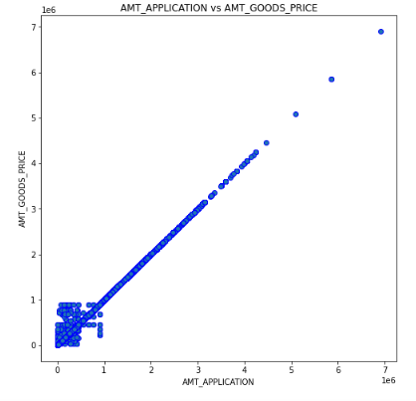
Bivariate Analysis on merged data : AMT_APPLICATION vs AMT_GOODS_PRICE

Slide 19
Understanding-
As observed, this shows a strong relationship between AMT_APPLICATION and AMT_GOODS_PRICE. AMT_APPLICATION means loan amount applied by client and AMT_GOODS_PRICE specifies the price of entity for which client is applying for loan. Hence, if client wants to purchase expensive commodity then client will apply for same amount of loan as price of commodity. This is the reason for direct relationship between variables.

Slide 20
Conclusions
Prioritize High Salaried people, Female applicants as they’re the ones who actually are able to repay the loan. More attractive schemes needs to be created in order to convince more people from these group.
As per Analysis, Laborers tend to default Loans more than any other Occupation Type group. In future, caution should be taken while disbursing loan to this particular Occupation Type’s person. This group gives a negative curve for people with less salary- as Laborers tend to default the most.
Percentage of people availing loan is higher in case of people with Higher Education and / or PhD. More attractive schemes needs to be created in order to convince more people from this group.
As per analysis, people with higher salary keep availing loans for different purposed. We can target these sector with different offers and discount rates in order to convince this group.

